Slide 1
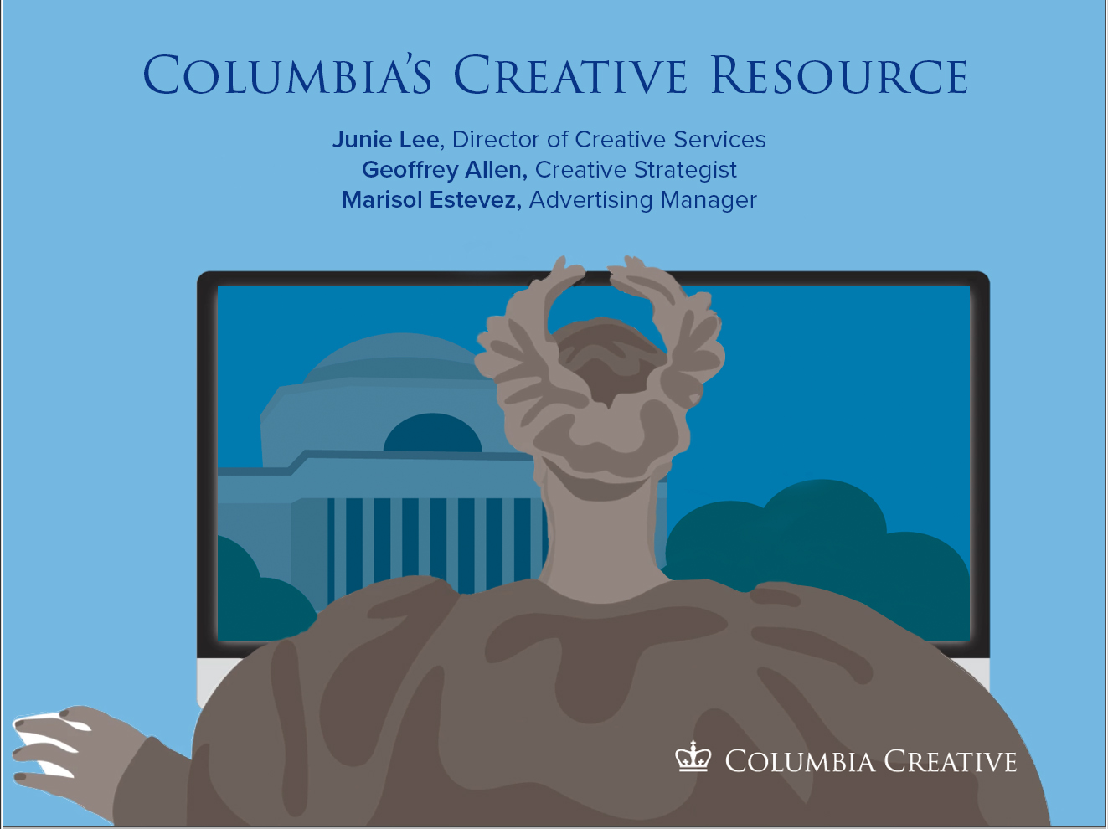

Slide 2
Columbia Creative is the central office for Columbia University’s visual communication, designing work for schools and colleges across the University.
Art Directors
Designers
Account managers
Editorial
Advertising
Columbia Creative provides design services at Columbia University and stewards the visual identity guidelines and University brand. As part of the Office of Communications and Public Affairs, we forge new standards for what can be achieved in visual communication through synergistic partnerships with our colleagues across the University.

Slide 3
Highest quality of design and client services
Strategic partnerships
Ingrained institutional knowledge
Full service shop
We are Columbia!
We have shared goals and interests, your success is our success

Slide 4
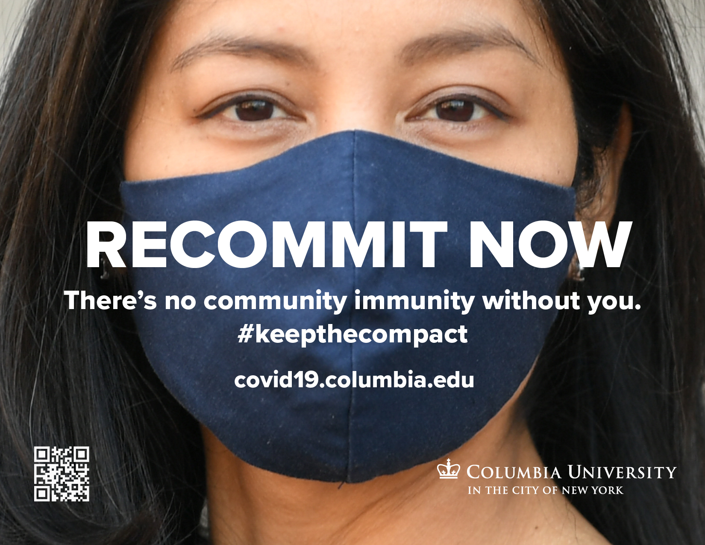

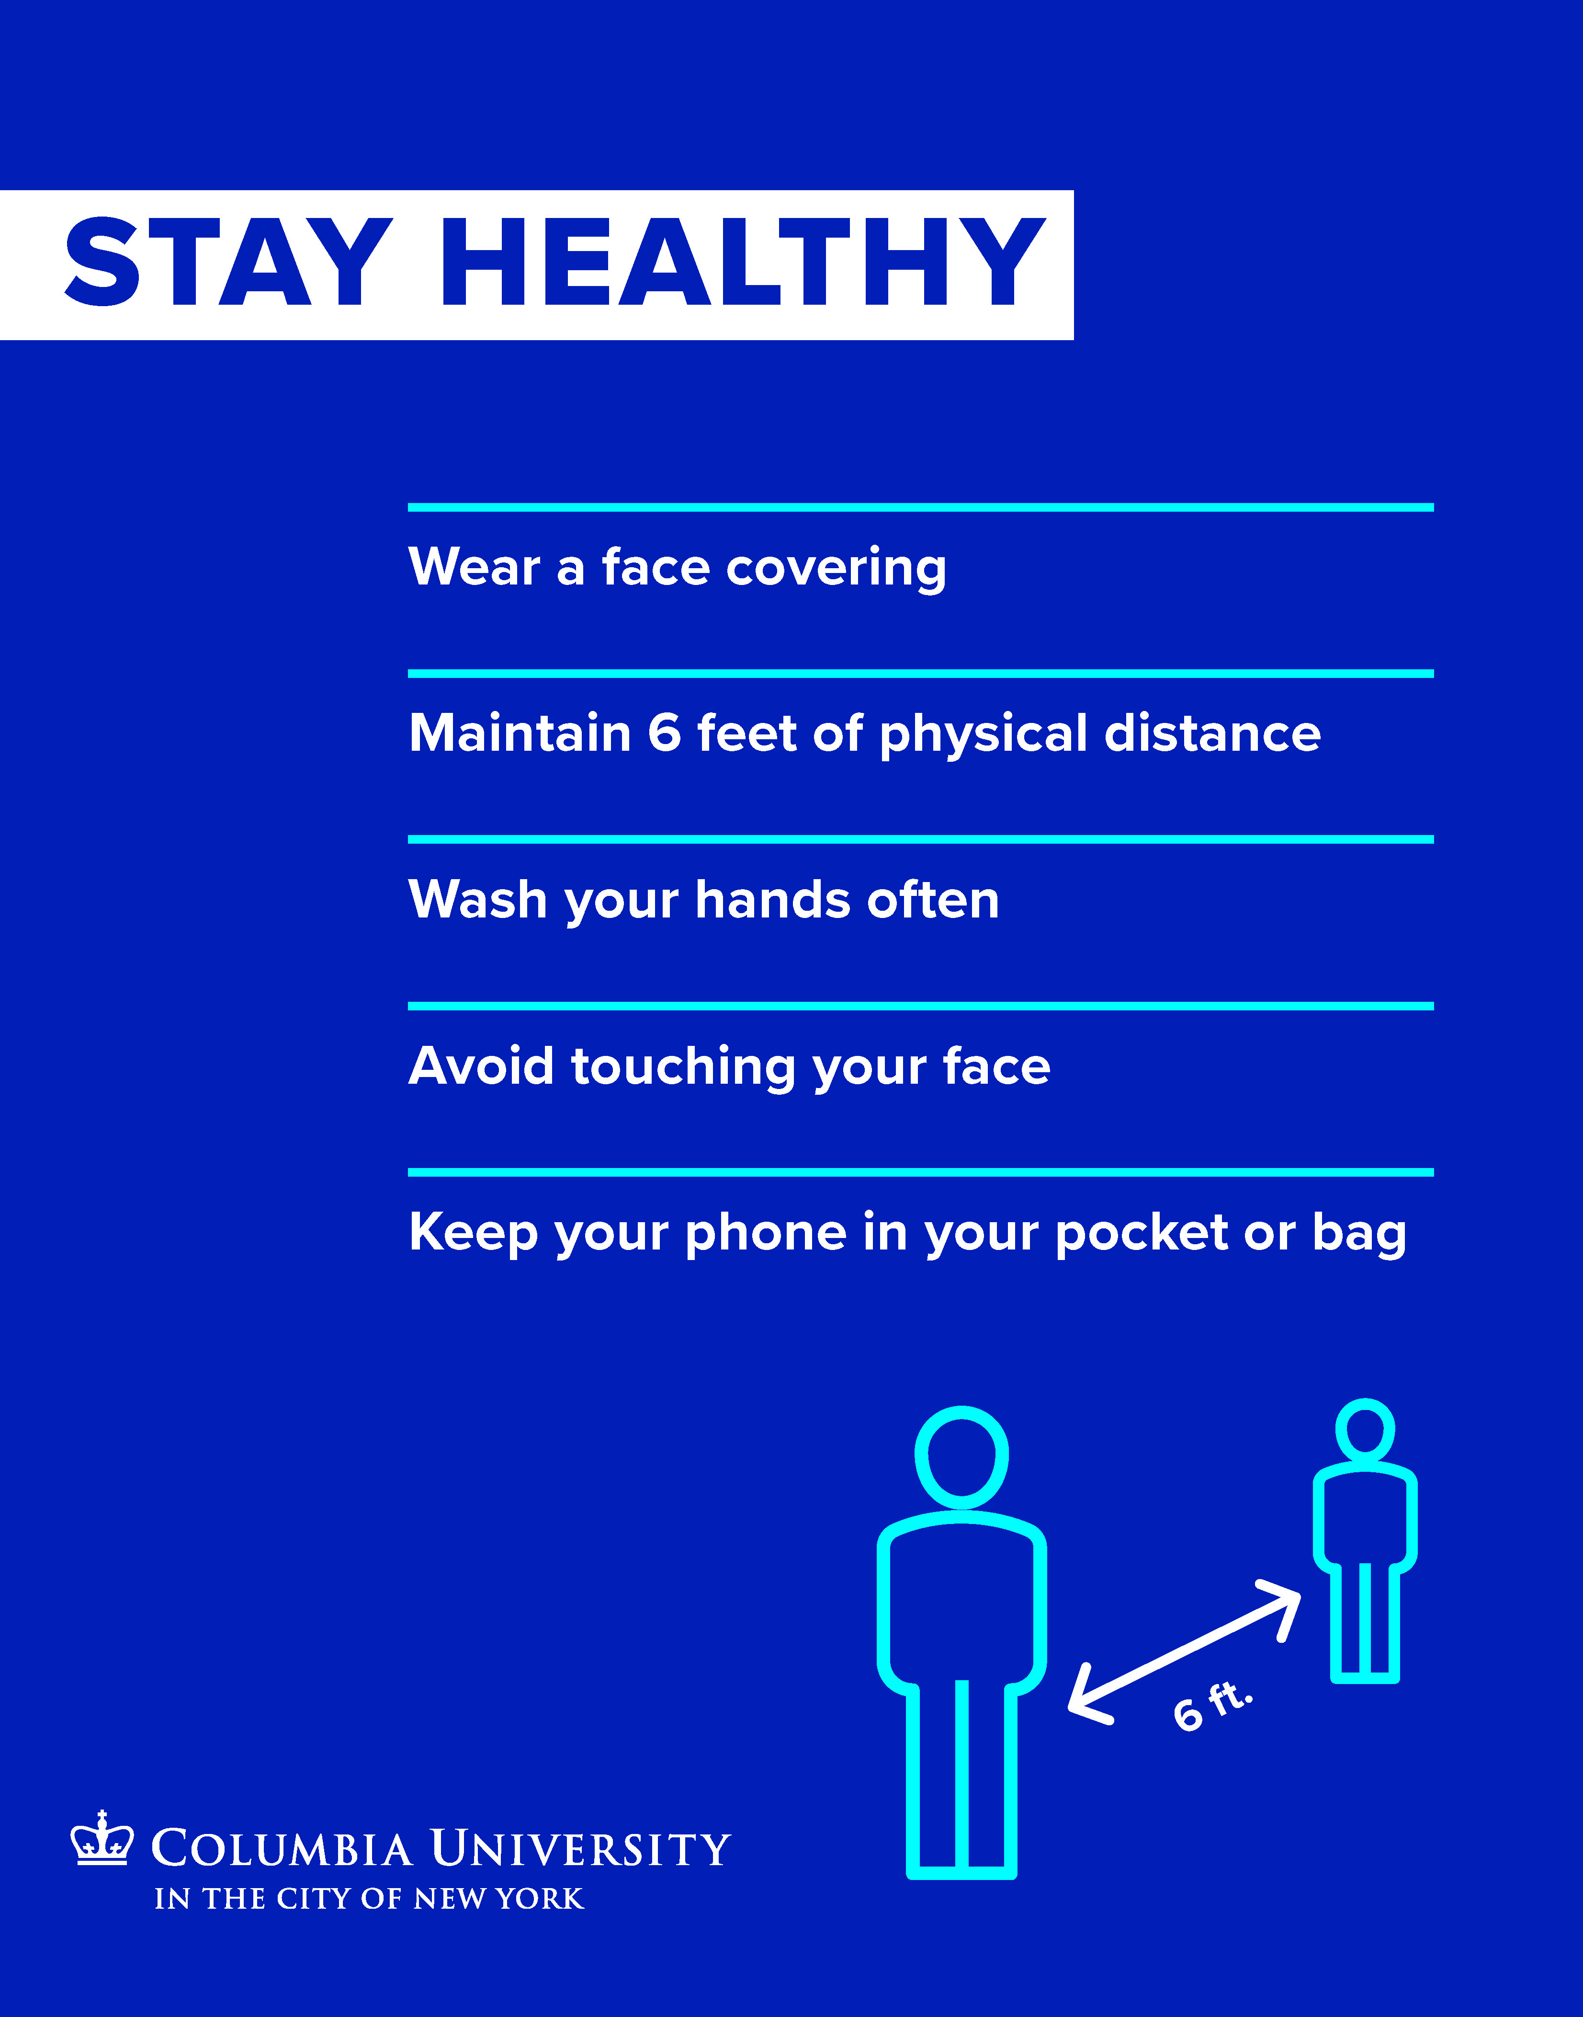



Slide 5

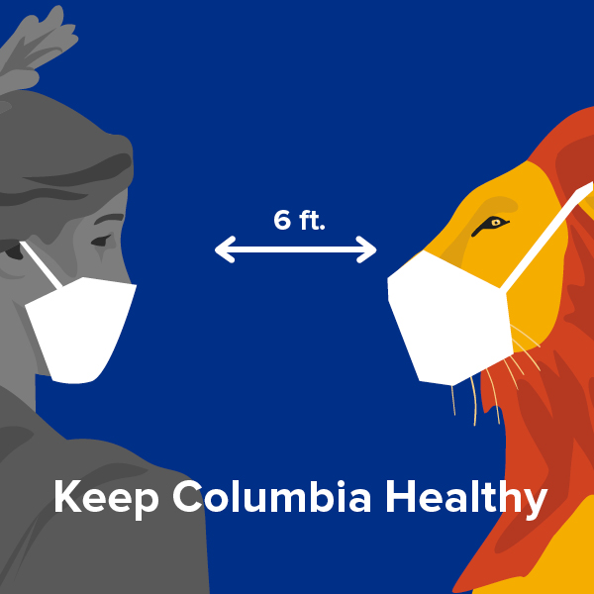



Slide 9
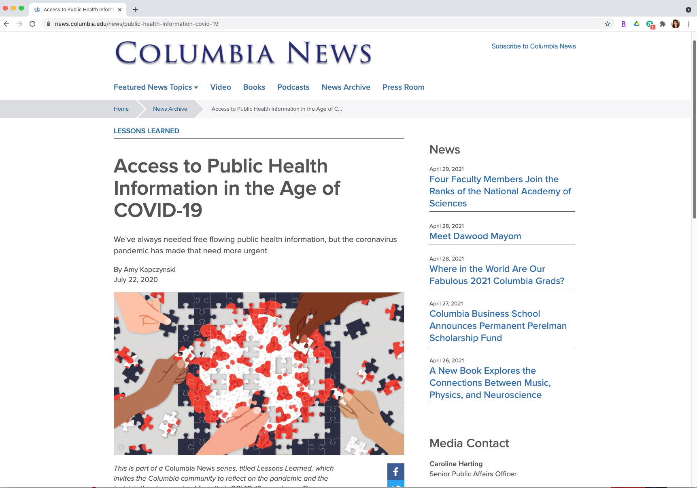

Slide 13
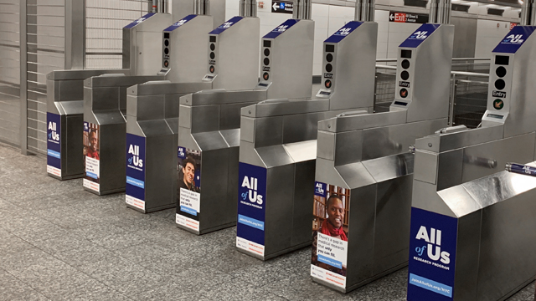

Slide 14
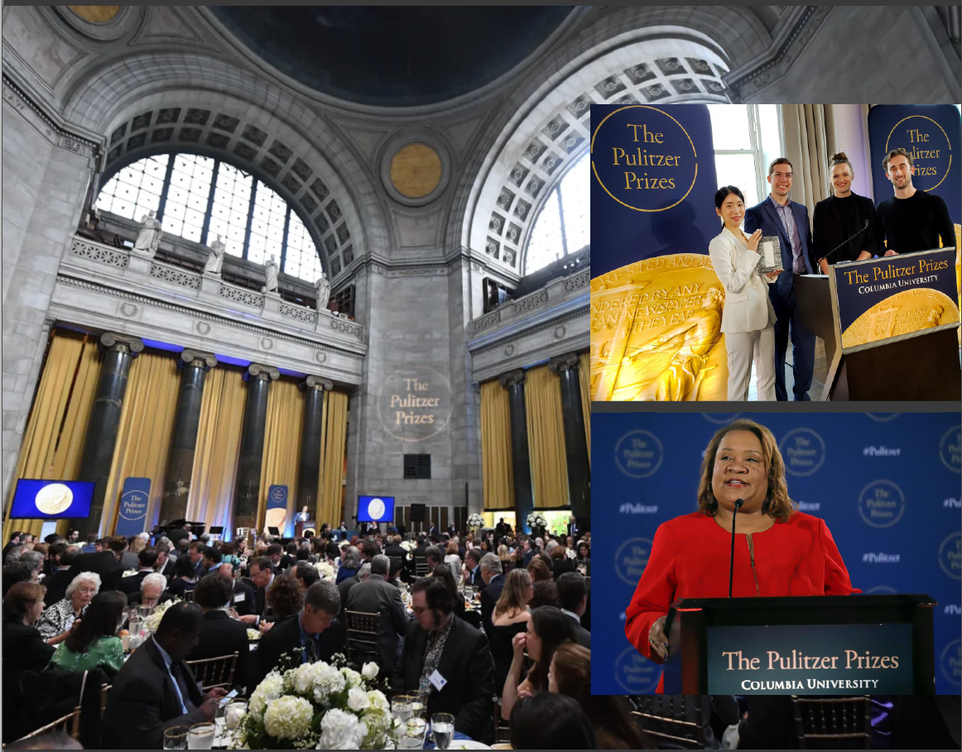

Slide 15
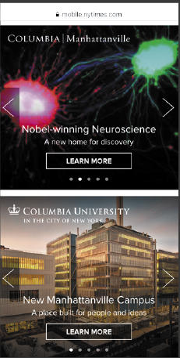
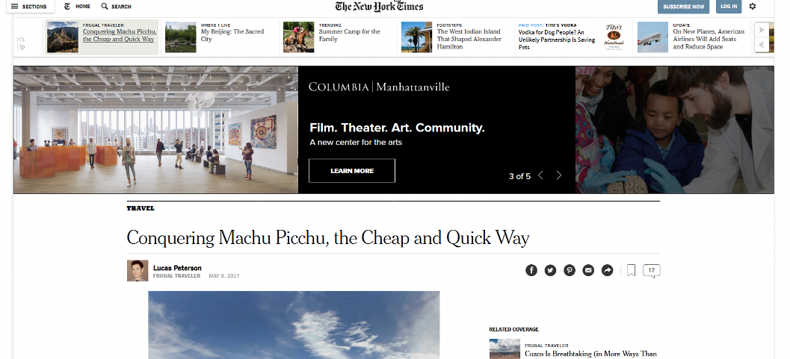
Columbiad
Display & Digital Ads
Research the best outlets to place your ads for your program/event
Analyze the data to measure the ads effectiveness and ROI

Slide 16
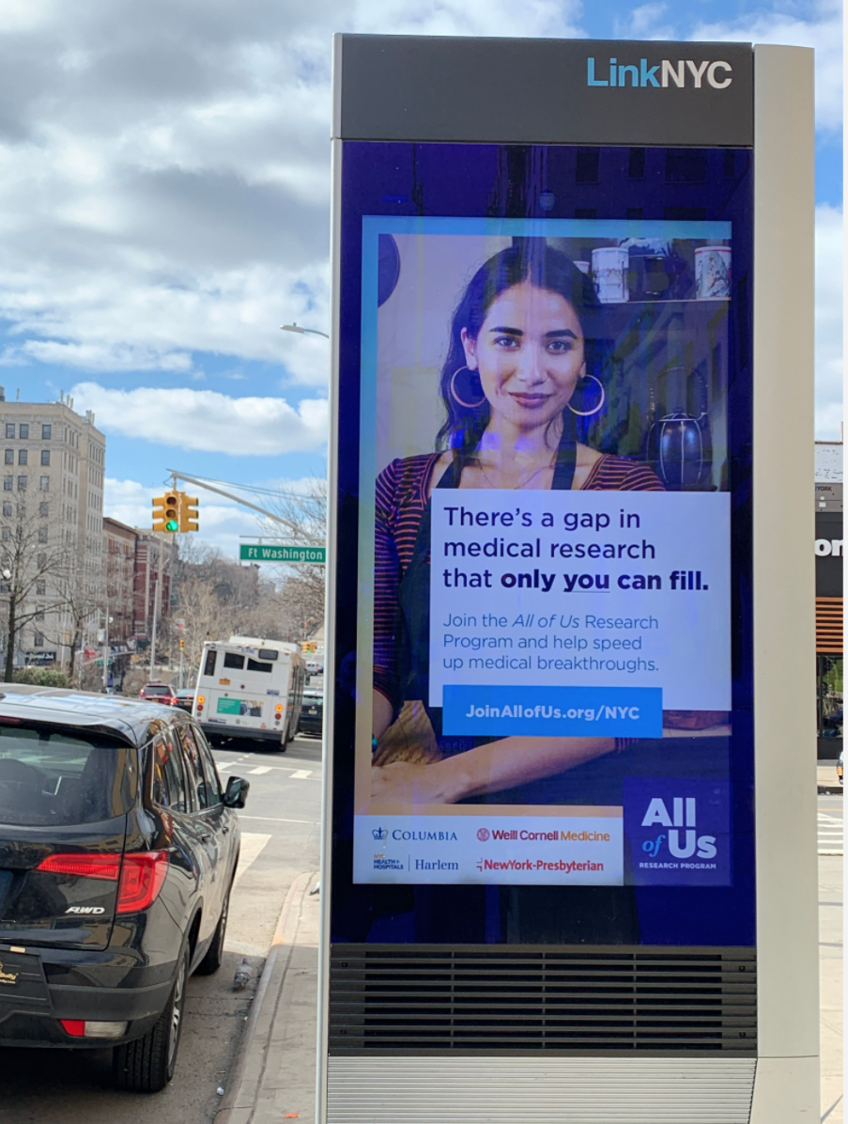
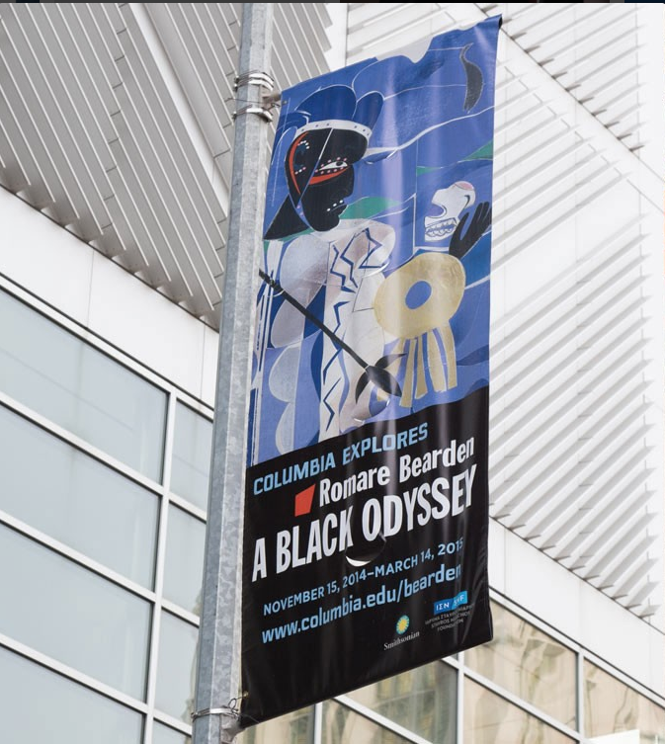
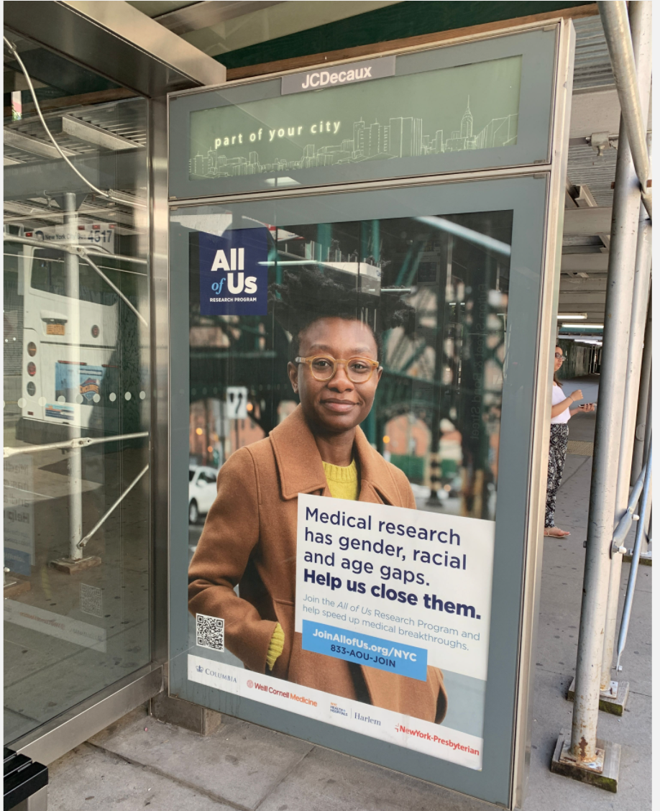
Environmental ads
MTA Subway Car and Stations, Bus Shelters, Full Turnstile Denomination
LinkNYC and Digital Urban Panels
Street Banners

Slide 17
Mailing List for direct mail marketing campaigns.
Email list GRE, GMAT & TOEFL.
Job Recruitment Ads

Slide 18
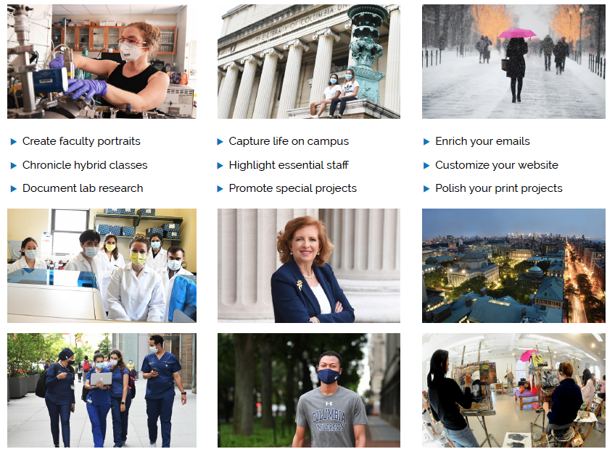
University Photographer: Eileen Barosso
eb6@Columbia.edu

Slide 19
Office of Public Affairs Video News Team
Pitch Us
The Office of Public Affairs video news team produces news style documentary, features, and social media video content for Columbia University News.
Our work is featured on Columbia University’s news website and other university social media platforms such as YouTube, Facebook, Instagram, Twitter, etc.
We focus on video stories that have news value or are of strategic importance to the university. If you have content that fits this criteria, the team can produce the video free of charge in exchange for editorial control by Columbia University’s executive team.
In addition to video work, we produce stock video content for the university and we provide consulting on video production.

Slide 20
Print Services
Invitation printing and mailing services
Event Programs and Booklets
Promotional Items
Stationery and Business Cards
Covid Safety Signage
Indoor/Outdoor Wall and
Window Graphics
Stickers/Labels
Bulk mailing
Packing and shipping services
Course Book printing
Thesis’
Class Handouts
Perfect bound Portfolios
Research Reports and Posters
Printing.Columbia.edu

Slide 21
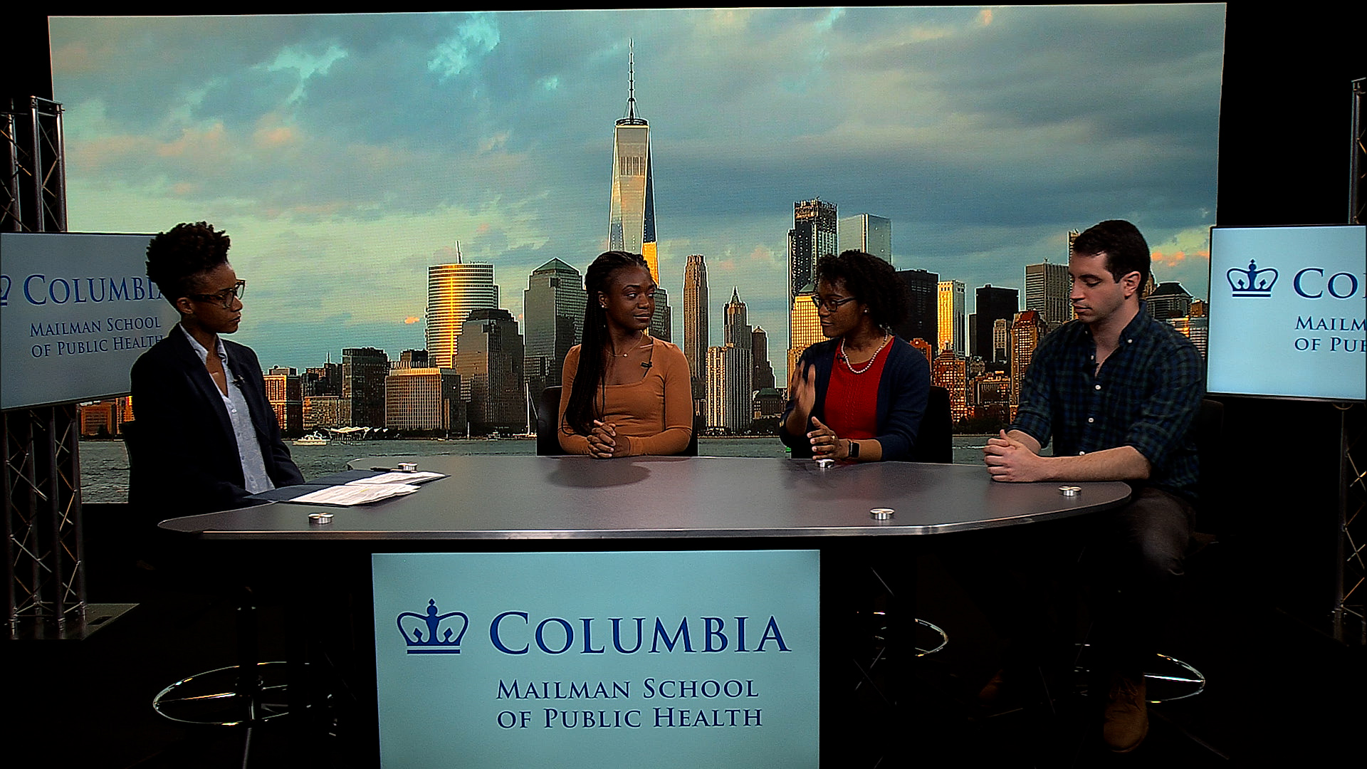
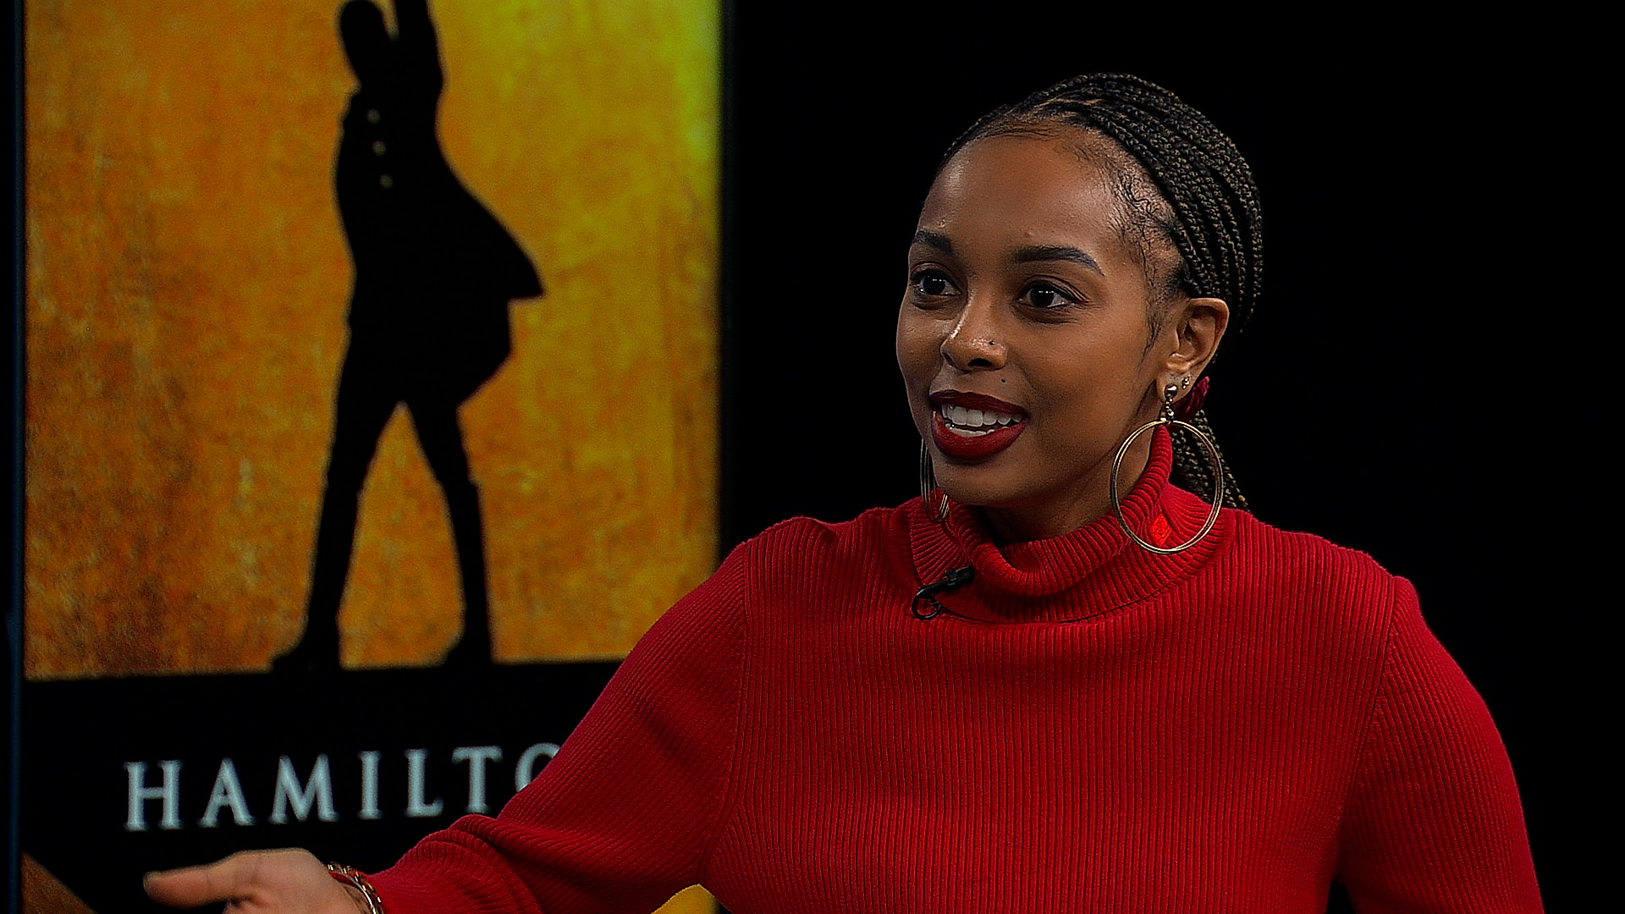
ww
Journalism Video/Audio Studio
Video Production Studio / Live Shots
The Columbia J‐School broadcast studio is available for use by both students and organizations. Live interviews and a variety of video production projects can be hosted in this facility.
ISDN Audio Production / Live Interviews
The ISDN audio studio is available for live interviews and a variety of audio production projects for both students and organizations.
journalism.columbia.edu/event-rentals

